Slide 1
Greenhouse Gas (GHG) emissions reduction strategies
February 2014

Slide 2
Four policy areas
Community Design
Pricing
Education and Marketing
Roads/Traffic Management

Slide 3
Implementation
Cost:
$ = <$100,000
$$ = $100,000 - $1,000,000
$$$ = >$1,000,000
Time frame:
Short = fully implementable within 5 years
Medium = implementable within 5 – 10 years
Long = implementable within 10 – 20 years, or longer
Notes:
- The following slides review strategies for reducing GHG emissions, grouped by policy area.
Each strategy is accompanied by cost and time frame information for implementation. All cost information refers to the public cost to implement the strategy (does not include private costs).
“Time frame” refers to the period of time it would take to fully implement the strategy. Note that it may require more time to fully realize the benefits of each strategy.

Slide 4
Greenhouse gas (GHG) impacts
Strategy effectiveness is measured in several ways:
GHG emissions reduction potential
Vehicle miles travelled (VMT) reduction potential
Qualitatively where there is little data on effectiveness
Notes:
- The GHG reduction strategies presented in the following slides have a wide range of effectiveness in reducing GHG emissions.
- In many cases, a GHG emissions reduction estimate is not available, and another, correlating measure – like reduction in per-capita vehicle miles travelled – is presented instead.

Slide 5
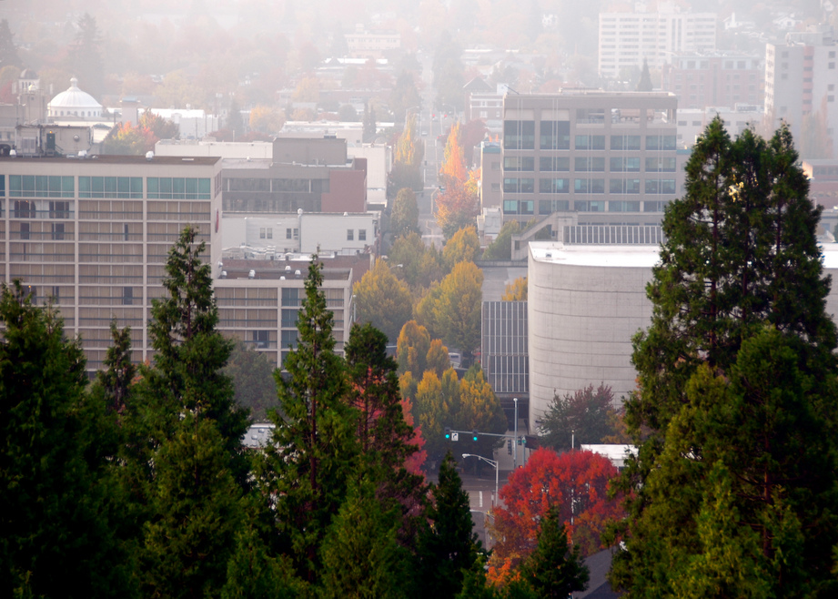
COMMUNITY DESIGN STRATEGIES
Photo courtesy Don Hankins

Slide 6
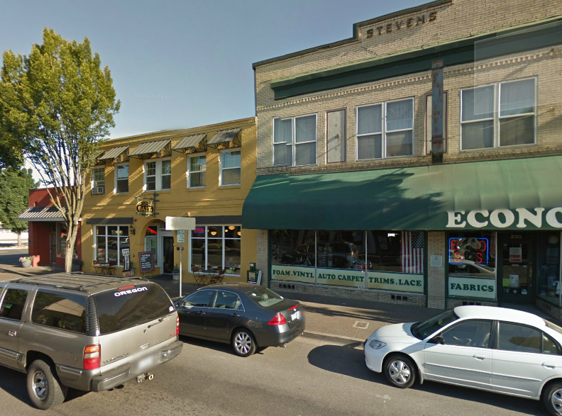
Mixed-use Development
5-25%
Vehicle miles traveled (VMT) reduction:

Slide 7
Implementation
Cost | Timeframe
$ | Short
$ - $$ | Short
$$ - $$$ | Medium
Mixed-use zoning
Developer incentives
Supportive public infrastructure
Notes:
Mixed-use zoning allows for a diversity of different land uses – residential, commercial, employment – to be located in close proximity to each other. Residents in mixed-use areas can meet many of their daily needs by walking or biking to nearby destinations.
Developer incentives, like grants, fee waivers, density bonuses, etc., can spur private development in mixed-use areas.
Infrastructure is needed to support development of mixed-use areas. Roads, sidewalks, streetscape improvements, transit, etc., can all provide the support needed to spur development of mixed-use areas.

Slide 8
Potential impacts
EQUITY
ECONOMY
HEALTH
$
Notes:
These strategies are likely to have a neutral effect on equity.
They are likely to boost the local economy my encouraging urban infill construction and increase efficiency of transit through new riders.
More people can meet their daily needs through walking or biking to daily destinations in mixed-use neighborhoods, imparting health benefits.

Slide 9
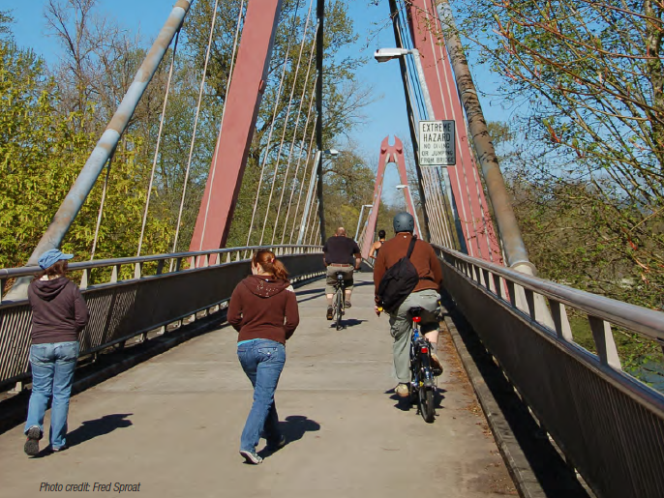
Active Transportation
5-15%
Vehicle miles traveled (VMT) reduction:
Notes:
Biking, walking, and transit are included in “active transportation.”

Slide 10
Implementation
Cost | Timeframe
$ | Short
$$ - $$$ | Medium
Developer regulations
Public infrastructure
Notes:
Developer regulations can be enacted that required new development to construct facilities that support active transportation. Impact fees can also be used to directly construct physical improvements.
Public infrastructure investment is expensive and can take time to program, but is the most direct way of improving transportation infrastructure.

Slide 11
Potential impacts
EQUITY
ECONOMY
HEALTH
$
Notes:
If improvements are distributed equally within the region, there are likely to be positive equity impacts.
There are not many direct economic impacts from improving public transportation. However, using active modes reduces the cost of transportation leading to indirect benefits.
More walking and biking will improve public health.

Slide 12
Improve public transit
1-8%
GHG emissions reduction potential:

Slide 13
Implementation
Cost | Timeframe
$$ | Short
$$ | Short
$$ - $$$ | Medium
$$$ | Long
Transit amenities
Reduce transit fares
Increase service
Increase high capacity transit
Notes:
Transit amenities: add shelters, real-time schedule information, benches, etc. Makes transit more attractive.
Reduce fares: reducing fares attracts more riders – on average, a 10% decrease in fares results in a 4% increase in ridership (dependent on local conditions)
Increase service: Adding additional routes or increasing service frequencies (more busses per hour) attracts more riders.
High capacity transit, like bus rapid transit or light rail, provides high-quality, high capacity transit service. These services are expensive and require accompanying land use changes to ensure that they are well-utilized.

Slide 14
Potential impacts
EQUITY
ECONOMY
HEALTH
$
Notes:
Transit improvements can improve equity outcomes if distributed fairly across the region.
Transit reduces the cost of travel and can also stimulate development.
Transit can help improve air quality and promote other forms of active transport, like biking and walking.

Slide 15
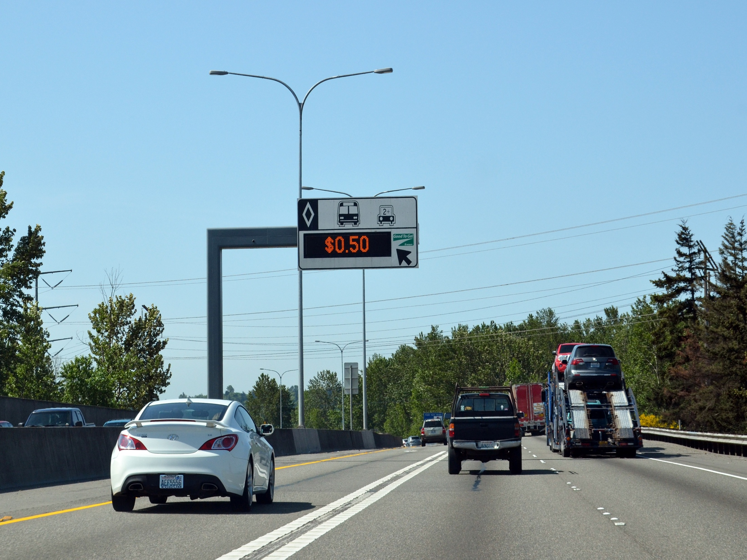
PRICING STRATEGIES
Photo courtesy WSDOT
Notes:
“Pricing” strategies change the cost of driving, making other transport modes more attractive.

Slide 16
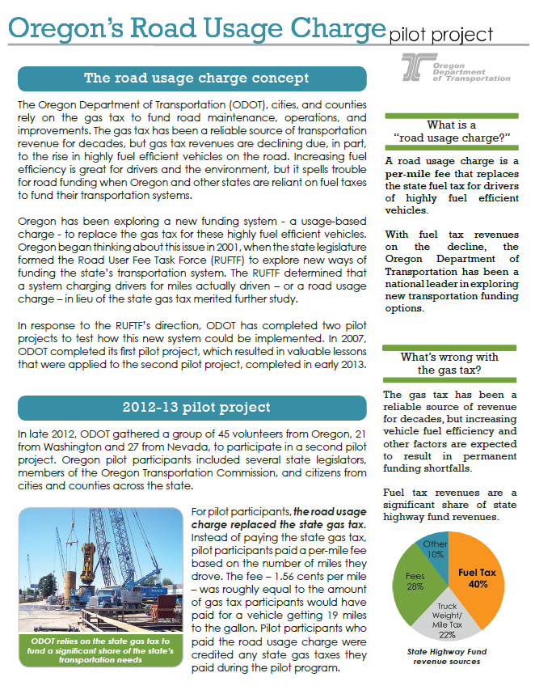
Congestion pricing
Mileage fee
GHG emissions reduction potential:
1-2%
GHG emissions reduction potential:
1-5%

Slide 17
Implementation
Cost | Timeframe
$$$ | Long
$$$ | Long
Congestion pricing
Statewide mileage fee
Notes:
Congestion pricing: charge drivers for driving during peak hours; the costs goes up as congestion increases. -Congestion pricing can reduce congestion and also encourage
Congestion pricing could potentially be implemented at the regional level, but it would likely be very costly.
There is potential to integrate congestion pricing with a mileage fee.
Mileage fee: Oregon has tested a per-mile-travelled fee as a replacement for the gas tax. A per-mile fee is only practical to implement at the state level.
Both strategies are effective at reducing driving and increasing use of alternate modes.

Slide 18
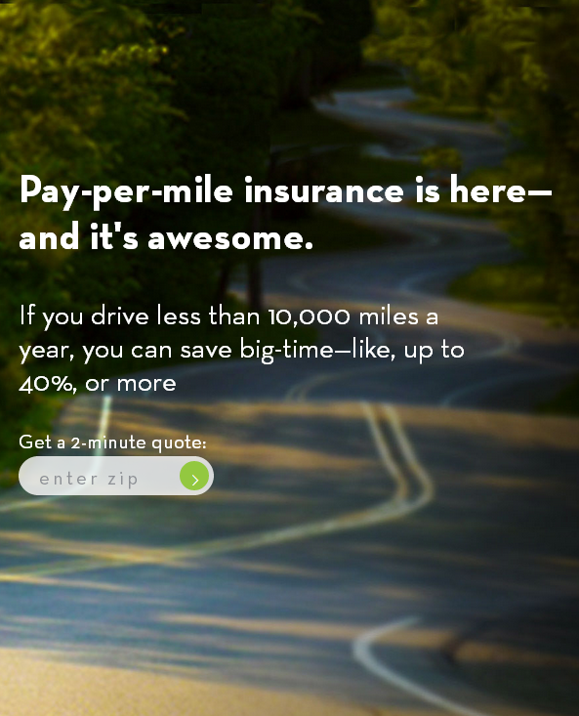
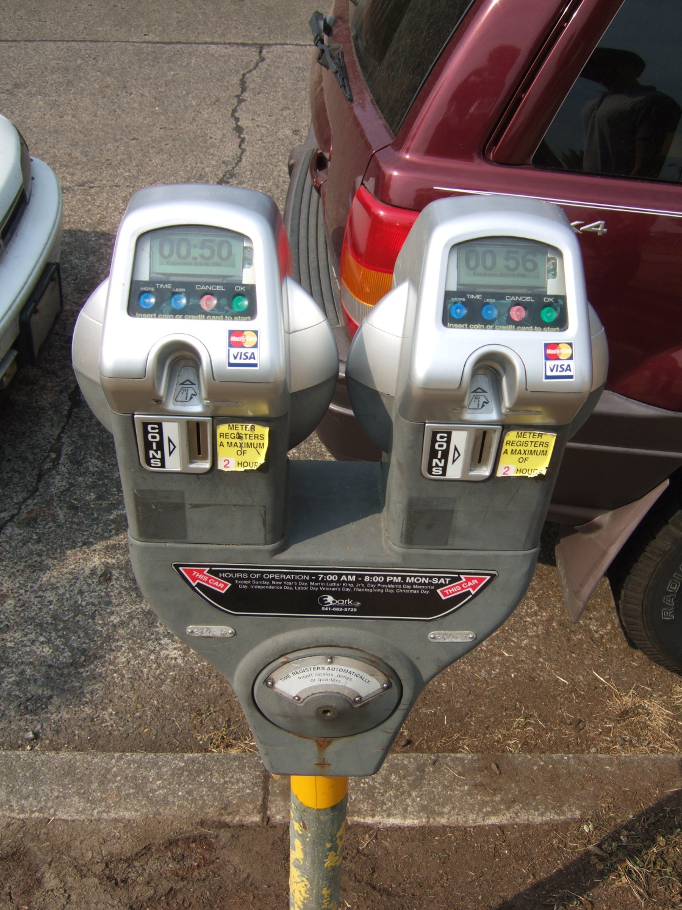
Other pricing strategies
Pay-as-you-drive insurance
GHG emissions reduction potential:
1-3%
GHG emissions reduction potential:
1-2%
Notes:
Other pricing strategies include parking pricing, increasing gas tax and carbon taxes.

Slide 19
Implementation
Cost | Timeframe
$$$ | Long
$$$ | Long
Pay-as-you-drive insurance
Parking pricing
Increase gas tax
Carbon pricing
Notes:
Pay-as-you-drive insurance charges drivers for every mile they drive, as opposed to an annual or semi annual flat fee. Much like a mileage fee, pay-as-you-drive insurance generally encourages drivers to drive less.
Charging for parking can have a big impact on mode choice – the higher the cost to park, the more likely a driver is to switch to an alternate mode.
Increasing the gas tax and carbon pricing both increase the cost of driving and encourage switching to alternate modes. Carbon pricing – or a tax on carbon dioxide emissions - is typically implemented as an additional charge on gasoline.

Slide 20
Potential impacts
EQUITY
ECONOMY
HEALTH
$
Notes:
Pricing strategies increase the cost of driving, which may disproportionately harm low-income individuals dependent on cars. These negative effects can be mitigated by ensuring quality transportation options are provided in low-income communities.
While pricing strategies increase the cost of driving, they also generate new revenue for projects and improvements.
Pricing strategies encourage drivers to shift to other modes like biking or walking.

Slide 21
EDUCATION & MARKETING STRATEGIES

Slide 22
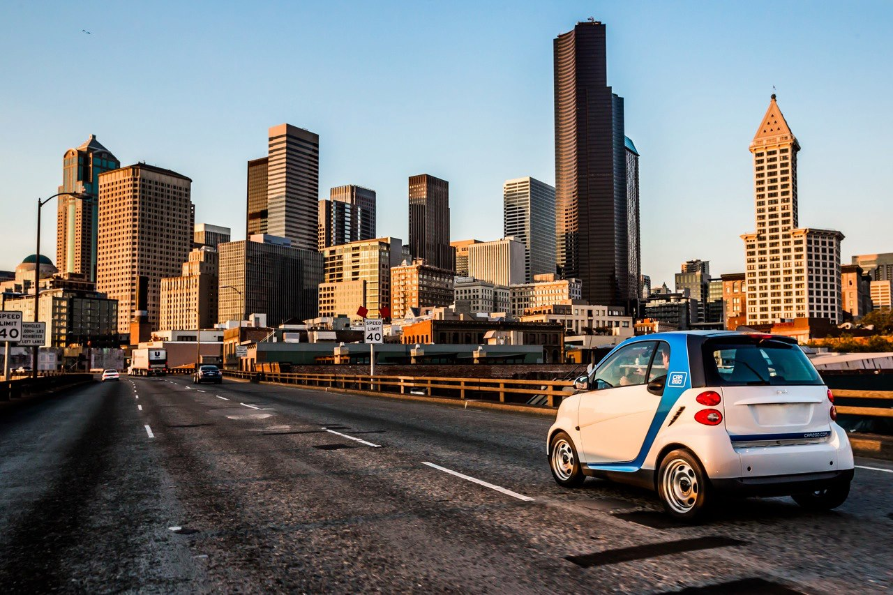
Ridesharing, carsharing, and carpooling
GHG emissions reduction potential:
Dependent on level of participation

Slide 23
Implementation
Cost | Timeframe
$$$ | Long
$$$ | Long
Carsharing
Carpooling
Ridesharing programs
Notes:
Carsharing is a model of car rental where users rent cars for a short period of time. Car2Go and Zipcar are examples of car share companies. Carsharing allows users to meet their trip needs without owning their own vehicle. Government agencies can encourage participation in carsharing programs.
Government agencies can facilitate carpooling at their respective agencies and also develop programs and incentives that encourage carpooling.
Ridesharing programs, like Oregon’s “drive less – connect” program match drivers with those needing rides to the same location.

Slide 24
Travel options education
Telecommuting
Vehicle miles travelled reduction potential:
1-3%
Commute trips reduction:
1-6%
Notes:
Travel options education provides information about different ways to get around, with programs often directed toward commuters. Incentives are also sometimes provided, like contests or prizes. Portland’s SmartTrips program targets a different part of the city each year with information on local trails, bicycle routes, and transit routes.
Telecommuting allows employees to work at home, reducing commute trips.

Slide 25
Implementation
Cost | Timeframe
$ | Medium
$ | Short
Travel options education
Telecommuting
Notes:
- Travel options programs can be implemented at the local or regional level.
Government agencies can allow telecommuting for their employees and also encourage local employers to allow telecommuting for a portion of the workweek.

Slide 26
Potential impacts
EQUITY
ECONOMY
HEALTH
$
Notes:
Education and marketing programs are typically only effective where travel options are readily available – these programs are ineffective at encourage shifts to other transport modes if a user’s only available choice is to drive alone.
These programs are typically inexpensive to implement and can reduce the cost of travel for users.
These programs generally decrease driving and car ownership and shift drivers to alternate modes.

Slide 27
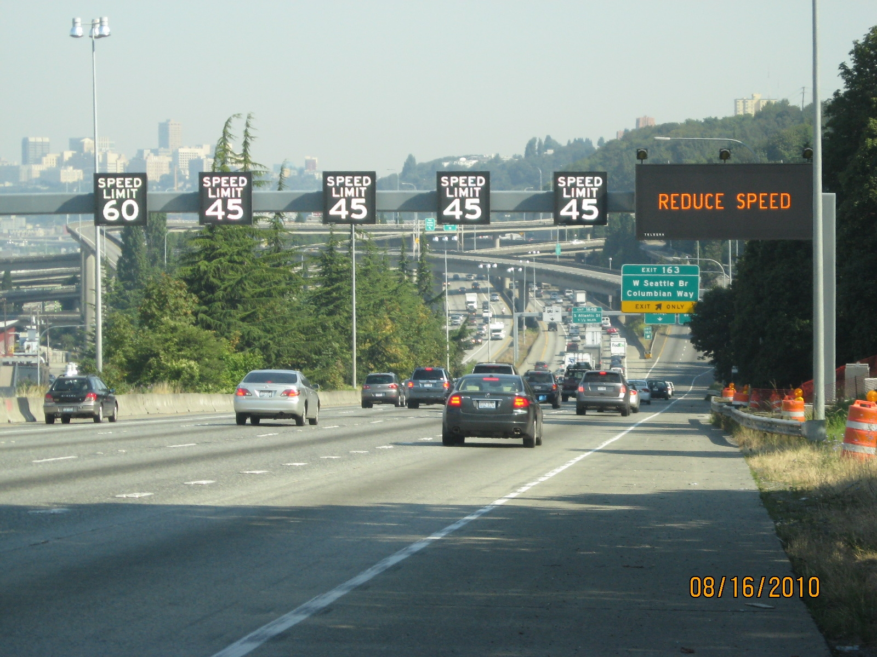
ROADS/TRAFFIC MANAGEMENT
Notes:
Traffic management strategies reduce congestion and wasted fuel from idling.

Slide 28
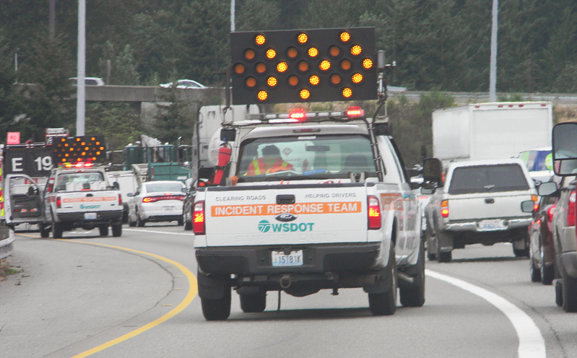
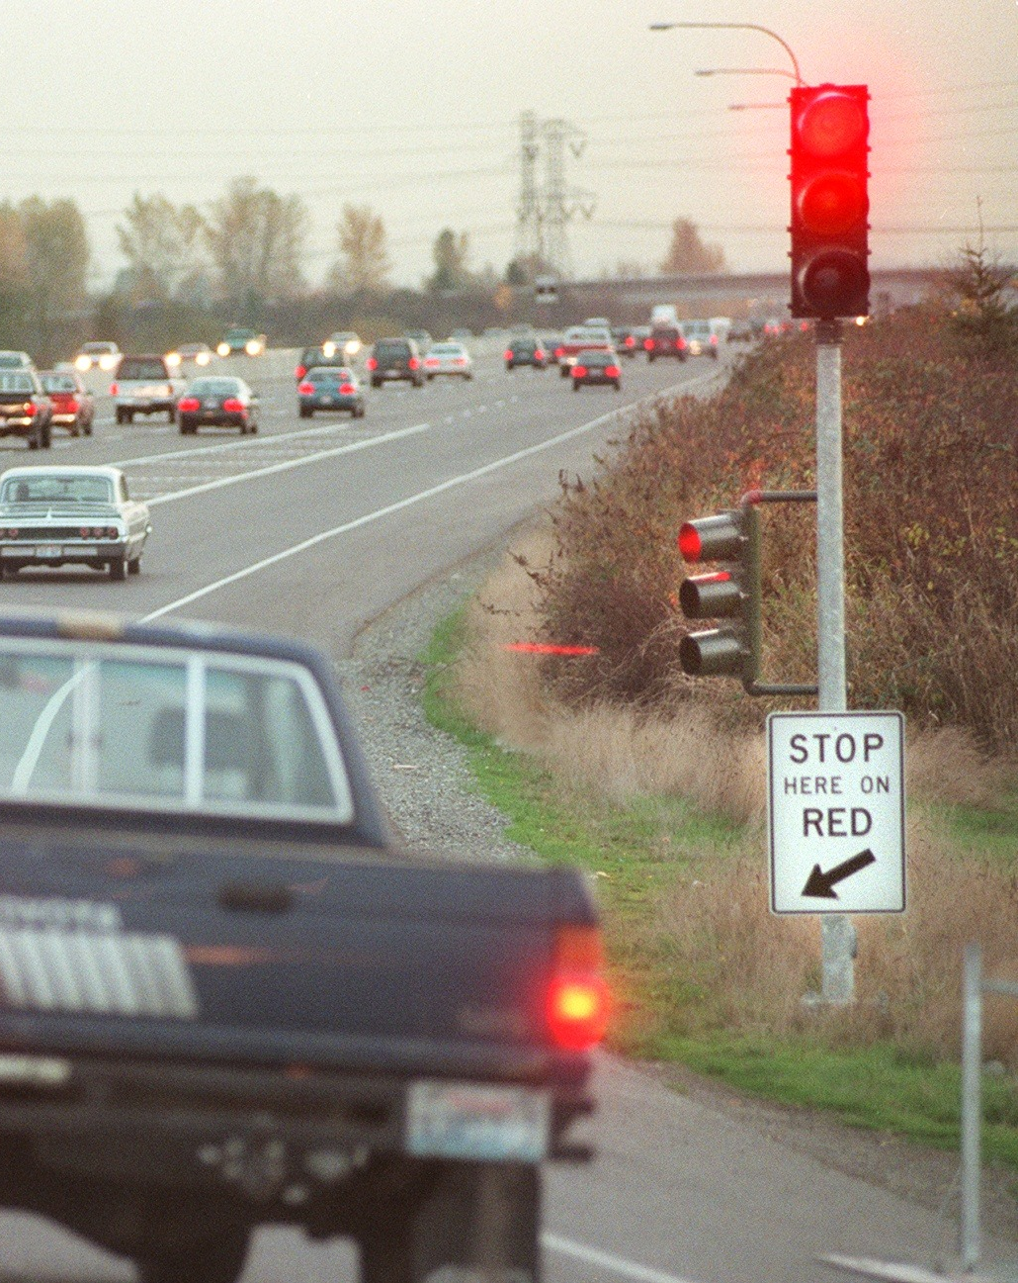
Incident management
Ramp meters/ signal coordination
Photo courtesy News Tribune
GHG reduction potential:
Minimal
GHG reduction potential:
Minimal
Notes:
The GHG reduction potential of these strategies is low. Model testing of these strategies within the Lane MPO reveals about a 1% emissions reduction when fully implemented.

Slide 29
Implementation
Cost | Timeframe
$$-$$$ | Medium
$$ | Short
$$ | Medium
Incident management
Traffic signal coordination
Ramp metering
Notes:
Incident management programs allow for quick response to highway collisions, reducing delay.
Traffic signal coordination increases travel speeds and reduces delay.
Ramp meters decrease highway congestion during peak travel hours.

Slide 30
Potential impacts
EQUITY
ECONOMY
HEALTH
$
Notes:
Traffic management strategies have limited impacts on equity.
These strategies reduce time wasted in congestion and decrease driving costs due to less wasted fuel.
These strategies help reduce air pollution, but also reduce congestion and may encourage more driving.

